Slide 1


Measuring E-commerce and Digital Economy
International Workshop on the Integrated Use of International Trade Statistics and Economic Statistics
24 November 2021
Daniel Ker, E-commerce and Digital Economy Branch
UNCTAD
daniel.ker@un.org

Slide 2
Outline
What is the digital economy?
The UNCTAD Manual
Measuring digital products
Measuring digital production
Measuring digital transactions
Take-aways

Slide 3
What is the digital economy?
Hard to define
Hard to agree on
Multi-faceted
Cuts across sectors and industries
Affects both what is produced and how
Both tangible and abstract
Different perspectives
How “digital” is enough?

Slide 4
One starting point: a definition of “economy”
Adapted (slightly) from Merriam-webster dictionary
  “the process or system by which
  goods and services are produced, sold and bought
  in a country [and internationally]”
Products
Transactions
Production
How “digital” is enough to be counted in
“the digital economy”?

Slide 5
How “digital” is enough?
Products
Production
Transactions
Products purely digital in form?
  Streaming services
  CAD designs
  Software (ICT product)
Producers of ICT products?
Computer makers
Software makers
Transactions that are agreed “digitally”?
  - Buying online
Products that can be digital or physical – when delivered digitally?
  e-books
  Training
  Banking services
Producers of products “digital in form”?
  Cloud services providers
Transactions where the payment takes place “digitally”?
  - Paying in a physical store by card, QR code, etc
Producers reliant on digital technology?
  Online platforms
Enabling (ICT) services?
  Telecommunications
  Data processing, hosting
  Repair of ICT equipment
Transactions where digital technology plays any role?
  - Car dealer advertises vehicle online but sale is in-person and paid by cash
Producers whose production is significantly altered or enhanced by using digital technology?
  Publishing
  Car makers
  Airlines
  Taxis
Enabling (ICT) goods?
  Computers, smartphones?
  Servers, Network switches?
Components?
  Processors, storage, sensors?
  Glass?
Connected versions of products?
  “Smart” TV/light bulb/fridge?
  Airbus A350?
Producers that make any use of digital technology?
  Hairdresser uses WeChat to schedule customer appointments
Data?

Slide 6
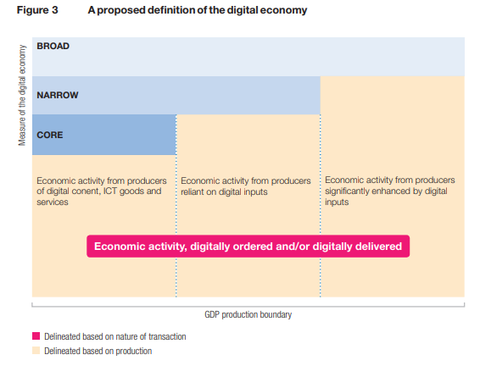
Drawing definitive boundaries is challenging
→ tiered definition of the digital economy
This example presented in the UNCTAD Manual, adapted from OECD report for the G20 (2020)
Emphasises:
  the nature of transactions
  producers
But producers belong to the different “measures” of the digital economy based on the nature of the products they make (digital or not) and also how “reliant” they are on digital inputs for production
Products
Producers
Transactions

Slide 7
We don’t have to agree everything to measure important aspects!
Products
Production
Transactions
Products purely digital in form?
  Streaming services
  CAD designs
  Software (ICT product)
Producers of ICT products?
Computer makers
Software makers
Transactions that are agreed “digitally”?
  - Buying online
ICT sector
E-commerce
ICT-enabled services
Products that can be digital or physical – when delivered digitally?
  e-books
  Training
  Banking services
Producers of products “digital in form”?
  Cloud services providers
Transactions where the payment takes place “digitally”?
  - Paying in a physical store by card, QR code, etc
Producers reliant on digital technology?
  Online platforms
Enabling (ICT) services?
  Telecommunications
  Data processing, hosting
  Repair of ICT equipment
Transactions where digital technology plays any role?
  - Car dealer advertises vehicle online but sale is in-person and paid by cash
ICT services
Producers whose production is significantly altered or enhanced by using digital technology?
  Publishing
  Car makers
  Airlines
  Taxis
Enabling (ICT) goods?
  Computers, smartphones?
  Servers, Network switches?
ICT usage in business
ICT goods
Components?
  Processors, storage, sensors?
  Glass?
Connected versions of products?
  “Smart” TV/light bulb/fridge?
  Airbus A350?
Producers that make any use of digital technology?
  Hairdresser uses WeChat to schedule customer appointments
Data?
Notes:
Its not to say that you can’t measure other parts or that efforts aren’t underway. Today we are going to look at some of the more widely established areas in as covered in...

Slide 8
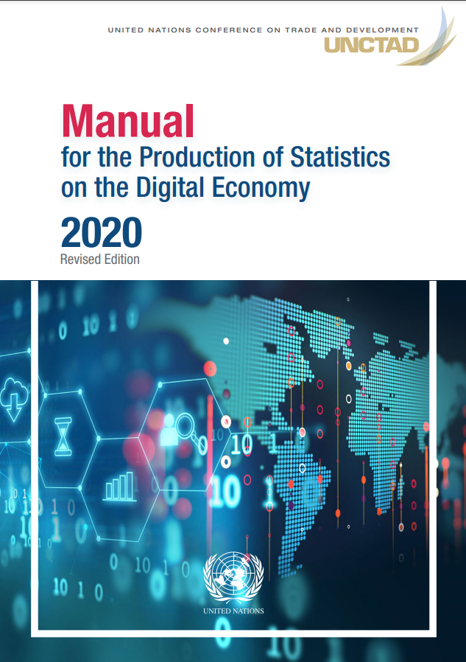
The UNCTAD manual
Core indicators on the digital economy
  Products
    ICT goods trade
    ICT services trade
    ICT-enabled (digitally delivered) services trade
  Production
    ICT sector (employment and value added)
    ICT usage in business
  Transactions
    E-commerce
Guidance on how to compile them
    data sources and methods
    survey design
    model questionnaire questions
    recommended breakdown
Guidance on presentation and dissemination
Notes:
Core indicators: Agreement across UN bodies and partner IOs established through The Partnership on Measuring ICT for Development and adopted by the UN Statistical Commission
Far from the only indicators that could be produced but if you have to prioritise, these are the ones which are recommended and available for the most countries

Slide 9
Measuring trade in digital products

Slide 10
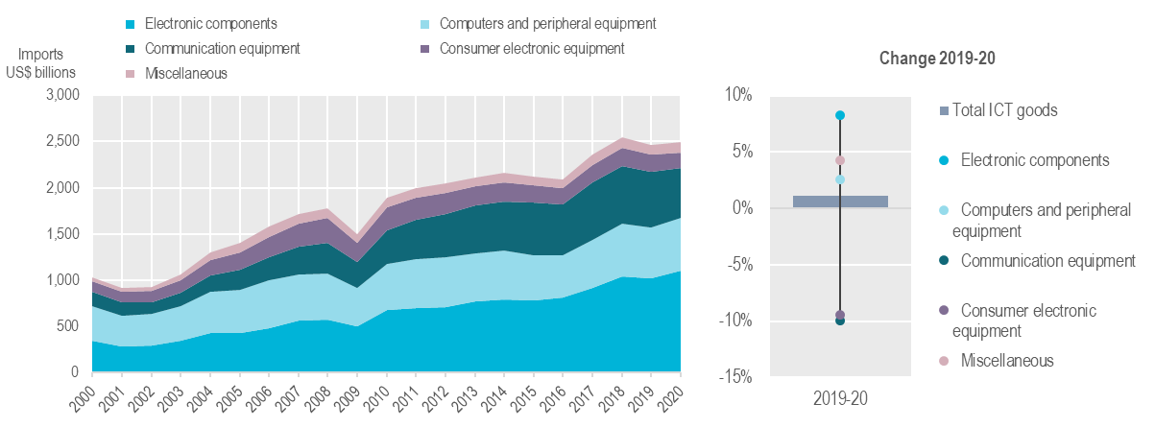
Measuring digital products: ICT goods trade
Core indicators
ICT goods classification developed by OECD 2003-2010
  Using both CPC (Central Product Classification) and HS
UNCTAD + UNSD maintain a list of ICT goods based on HS for compilers to use to identify and aggregate ICT goods within merchandise trade data
ICT3: ICT goods imports as a percentage of total imports
ICT 4: ICT goods exports as a percentage of total exports
ICT goods imports, by product
Source: Impacts of the COVID-19 Pandemic on Trade in the Digital Economy (https://unctad.org/system/files/official-document/tn_unctad_ict4d19_en.pdf)
Notes: current prices. Not adjusted for re-exports/re-imports due to data availability.

Slide 11
Measuring digital products: ICT services trade
Classification developed by OECD (2007-2010)
  Based on CPC, correspondence with EBOPS
Aggregated from trade data (EBOPS 2010):
Telecommunications services
Computer services
  Includes software
Licenses to reproduce or distribute computer software
Core indicators
ICT5: imports of ICT services as a proportion of total imports of services
ICT6: exports of ICT services as a proportion of total exports of services

Slide 12
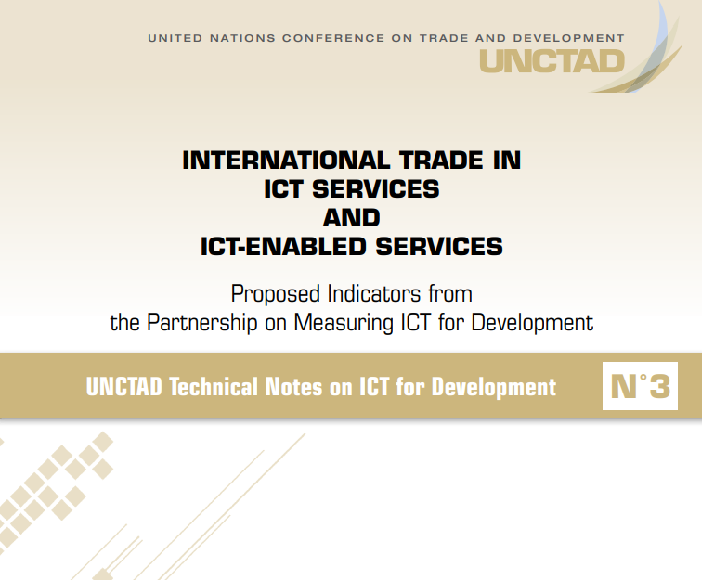
Measuring digital products: ICT-enabled services
ICT-enabled services:
“services delivered remotely over ICT networks”
(UNCTAD, 2015)
Similarly, digitally delivered trade:
“International transactions that are delivered remotely in an electronic format, using computer networks” (OECD-WTO-IMF, 2020)
Problem: trade sources do not routinely distinguish delivery over ICT networks.
Solution: surveys (or other sources) that can make the distinction.
Immediate work-around:
Identify services that can be (and are likely to be) delivered remotely over ICT networks. i.e. ,“Digitally deliverable services”.
Core indicators
ICT7: imports of ICT-enabled services as a proportion of total imports of services
ICT8: exports of ICT-enabled services as a proportion of total exports of services
ICT services
Sales and marketing services (excl. trade and leasing)
Information services
Insurance and financial services
Management, administration, and back-office services
Engineering, related technical services, and R&D
Education and training services

Slide 13
Measuring digital products: services trade
Global ICT and digitally deliverable services exports, 2005-2020 and 2019-2020
As a percentage of total services exports
Source: Impacts of the COVID-19 Pandemic on Trade in the Digital Economy (https://unctad.org/system/files/official-document/tn_unctad_ict4d19_en.pdf)

Slide 14
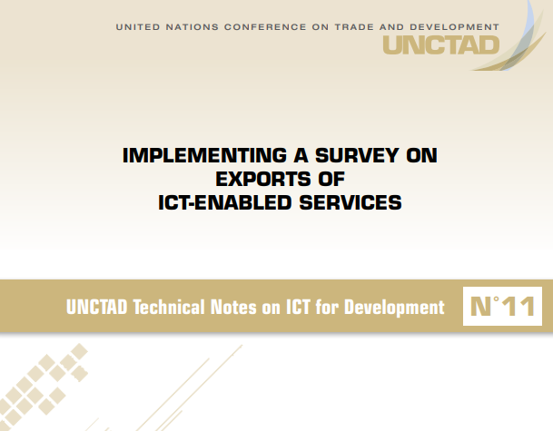
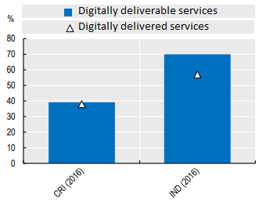
Digitally deliverable vs Digitally delivered products
Measuring the share of services actually digitally delivered entails collecting additional information
UNCTAD collaborated with partner countries (Costa Rica, India, Thailand) to develop a pilot
  targeted at resident service-exporting enterprises (excl. financial and insurance)
  Sampling frames (in order of preference):
    Balance of Payments register (of importing/exporting businesses), or
    Settlement register
    Business register, otherwise
    Lists of members of business/trade associations (with their help)
  Recommended methods
    Stratified sample; census of biggest units recommended
    Questionnaire available (see report);
      electronic version recommended
      cognitive testing recommended before full implementation
    Follow-up for non-response
Suggest 80+% of digitally deliverable are digitally delivered
Experience and lessons learned from 3 countries presented in the report.
UNCTAD keen to support and collaborate with more countries to implement surveys
Digitally deliverable services
% of services exports
Source: adapted from Implementing a survey on exports of ICT-enabled services (https://unctad.org/system/files/official-document/tn_unctad_ict4d11_en.pdf)
Notes:
BOP register or settlement register usually managed by central bank. Settlement register provides less info (e.g. for stratification).
General business register usually managed by NSO.

Slide 15
Measuring digital production

Slide 16
Measuring digital production: surveying ICT use in business
ICT usage surveys are widely used to investigate what digital technologies businesses are using and the intensity of use
  → Important tool for understanding how businesses are adapting to the digital age and what policy support may be needed
UNCTAD database (unctadstat.unctad.com) collates core indicators to facilitate international comparison
  Over 80 economies (23 of 52 economies in the UN Asia region)
  Enables international comparison
  → help to inform policy priorities and opportunities to work with and learn from others
All countries encouraged to implement business ICT surveys including the core indicators/questions
UNCTAD Manual is a practical guide designed to support this and ensure international comparability
  →provides detailed definitions, guidance on survey design and methods, model questions, etc.
UNCTAD facilitates practice sharing and offers tailored technical assistance and capacity building to support countries in implementing or improving business ICT surveys
Core indicators
Proportion of businesses:
B1: using computers
B3: using Internet
B5: with a web presence
B6: with an Intranet
B7: receiving orders over the Internet
B8: placing orders over the Internet
B10: with a LAN
B11: with an extranet
Proportion of businesses using the Internet:
B9: by type of access (narrowband, fixed/mobile broadband)
B12: by type of (online) activity
Proportion of persons employed
B2: routinely using computers
B4: routinely using the Internet
+ proposed indicators on mobile use
Notes:
Mention help with finding funding
Facilitate practice sharing

Slide 17
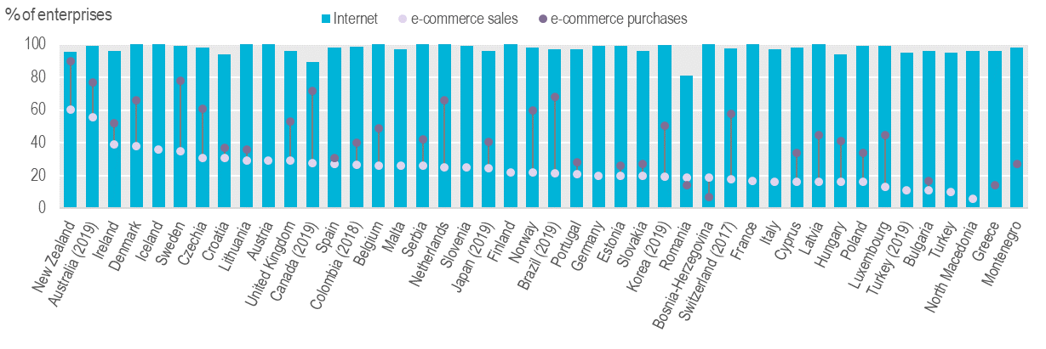
Measuring digital production: selected results
Businesses using the Internet, 2020 or latest
Note: e-commerce purchases relate to 2018 for European Statistical System Countries and Japan. 10+ persons employed
Source: UNCTAD based on Eurostat Digital Economy and Society Indicators (https://ec.europa.eu/eurostat/web/digital-economy-and-society/data/database),
OECD ICT Usage in Business (https://stats.oecd.org/Index.aspx?DataSetCode=ICT_BUS)

Slide 18
Measuring digital transactions

Slide 19
Measuring digital transactions: e-commerce
What is e-commerce? (OECD, 2011)
  “An e-commerce transaction is the sale or purchase of goods or services, conducted over computer networks by methods specifically designed for the purpose of receiving or placing of orders.
  The goods or services are ordered by those methods, but the payment and the ultimate delivery of the goods or services do not have to be conducted online. An e-commerce transaction can be between enterprises, households, individuals, governments, and other public or private organisations.”
  Include: orders made via web pages, extranet, or via electronic data interchange (EDI)
  Exclude: orders by telephone [calls], fax or [typed messages incl. email]
The definition of Digitally ordered trade builds upon this (OECD-WTO-IMF, 2020):
  “The international sale or purchase of a good or service, conducted over computer networks by methods specifically designed for the purpose of receiving or placing orders”
Key difference is a focus on cross-border transactions.
A key distinction within e-commerce is between:
  Business-to-business (B2B) transactions (around 80% of the total on average)
  Business-to-consumer (B2C) transactions (around 20% on average)

Slide 20
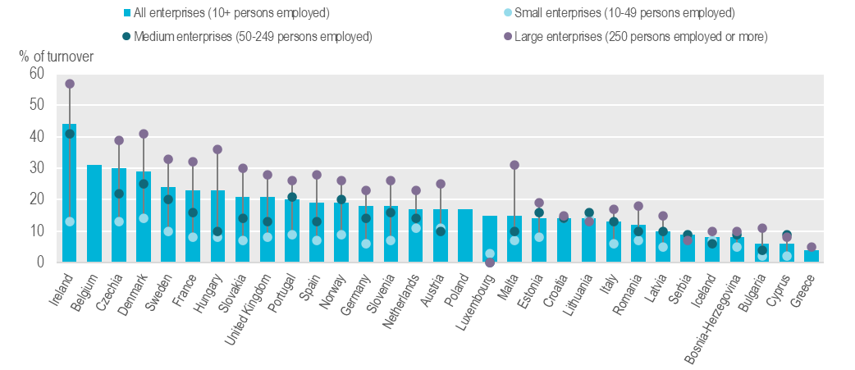
Measuring e-commerce
Business ICT usage surveys measure firms engaging in e-commerce
However, this does not tell us about the economic value of e-commerce
→ Some ICT use surveys ask respondents what % of their sales revenue is from e-commerce:
Source: UNCTAD based on Eurostat “Value of e-commerce sales” database (https://ec.europa.eu/eurostat/databrowser/view/ISOC_EC_EVALN2__custom_1556983/default/table?lang=en)

Slide 21
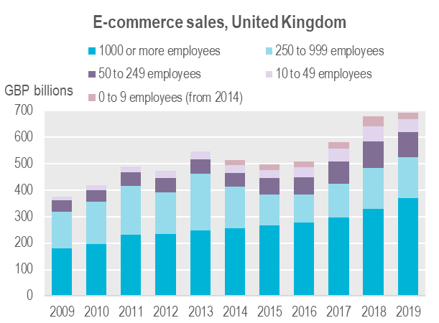
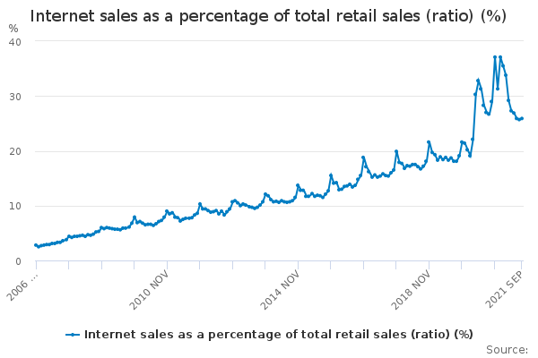
Measuring e-commerce value
Business ICT usage surveys measure firms engaging in e-commerce
However, this does not tell us about the economic value of e-commerce
Some ICT use surveys ask respondents what % of their sales revenue is from e-commerce
Some also ask about the monetary turnover from e-commerce or the total turnover of the business (from which the above % can be used to derive e-commerce value)
Some countries complement this by using retail sales sources to measure a subset (25%) of B2C e-commerce
United Kingdom
Source: UK Office for National Statistics
Notes:
Value chains

Slide 22
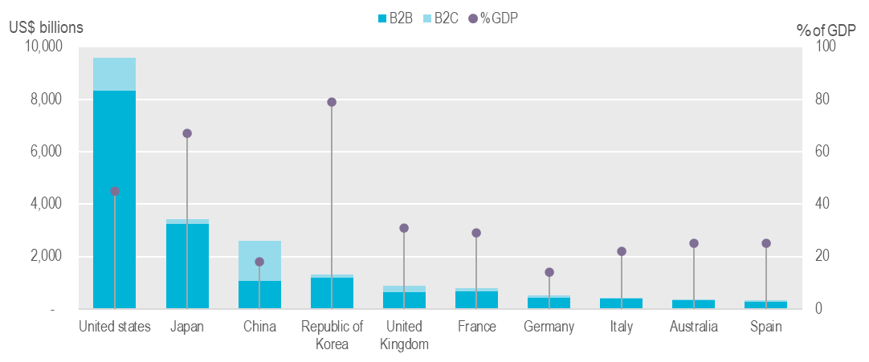
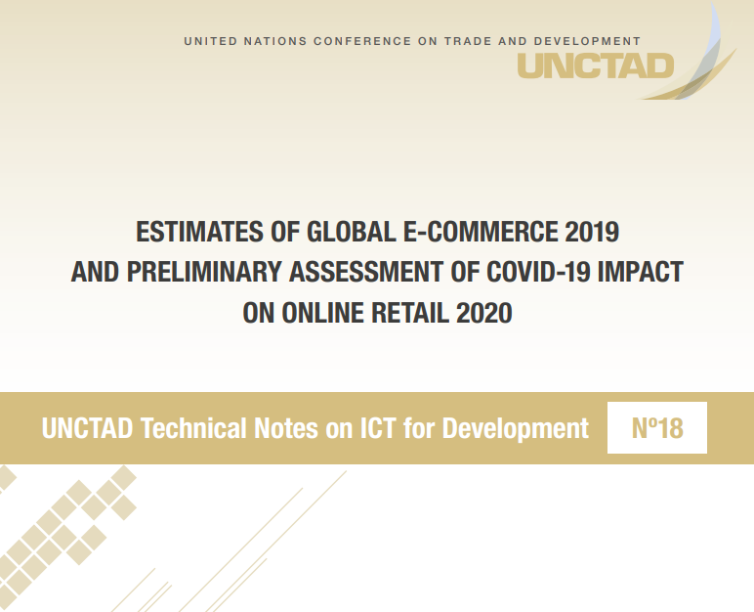
Measuring e-commerce value
E-commerce sales, estimates, 2019
Source: UNCTAD, estimated based on National Sources.
See “Estimates of global e-commerce 2019 and preliminary assessment of COVID-19 impact on online retail 2020
(https://unctad.org/system/files/official-document/tn_unctad_ict4d18_en.pdf)

Slide 23
Measuring international e-commerce
Business ICT usage surveys can also be used to ask firms whether they make e-commerce sales to customers in different countries
  e.g. EU surveys ask firms whether they sell to customers in other EU countries, outside, or both
  Can be extended to ask firms to provide information on the value of e-commerce sales to customers abroad
  → estimates breaking down the total value of business’ e-commerce revenues into domestic and foreign (export) components.
  = an important step forward
However, the ultimate aim should be bi-lateral digitally ordered (i.e. e-commerce) trade data
Some countries have begun making steps in this direction.
  For example, METI (Japan) has published information on bi-lateral e-commerce flows between Japan and China and the United States
  In 2019, “the amount purchased through cross-border EC by Chinese consumers from Japanese business operators w as 1.6558 trillion yen (up by 7.9% from the previous year)”
  (METI, 2020; https://www.meti.go.jp/english/press/2020/0722_005.html)
UNCTAD reviewing developments and methods being applied in this area with the aim of identifying and sharing emerging practices.

Slide 24
Take-aways
The digital economy is hard to define – but there is precedent and guidance for measuring key components
It is important to ensure international comparability in producing core indictors
  → the UNCTAD Manual is a foundation for this
Digitally deliverable trade accounts for two-thirds of services trade in 2020;there is a need to further develop sources to identify how much is actually digitally delivered
  → UNCTAD pilot questionnaire available, collaboration welcome
An increasing number of countries have moved beyond measuring business uptake of e-commerce to e-commerce value.
There is a need to further delineate international e-commerce (i.e., digitally ordered trade)
UNCTAD is undertaking work to improve our ability to support members in measuring the value of e-commerce (including international e-commerce) and aims to issue guidance to help ensure robustness and comparability of e-commerce value figures

